Slide 1

UCKS
YOUR FINANCIAL FRIEND
Stevenson Michel, Founder & CEO
CSC 493 - Computing Design Practicum
12 December, 2024

Slide 2
1-PROBLEMS WITH FINANCE
Struggle in recording personal expenses
Difficulty with consistent budget
Inacurracy of personal decisions regarding finance
Well, the US national debt is ... trillions!

Slide 3
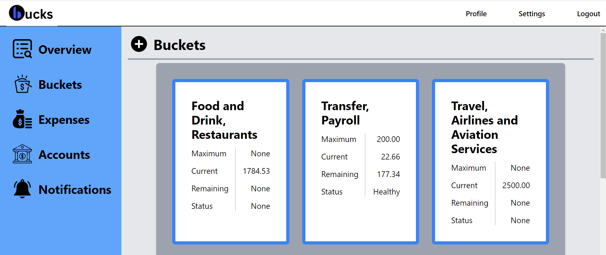
2.1-MAIN FEATURES DEMO
Bucket for categorization of expenses

Slide 4
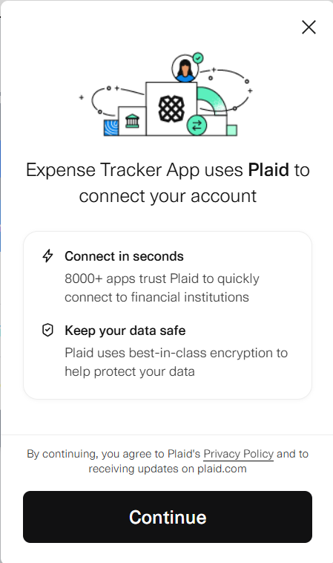
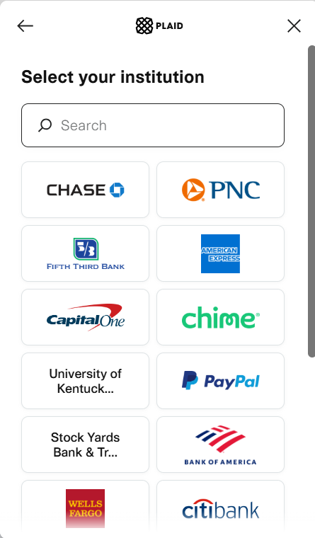
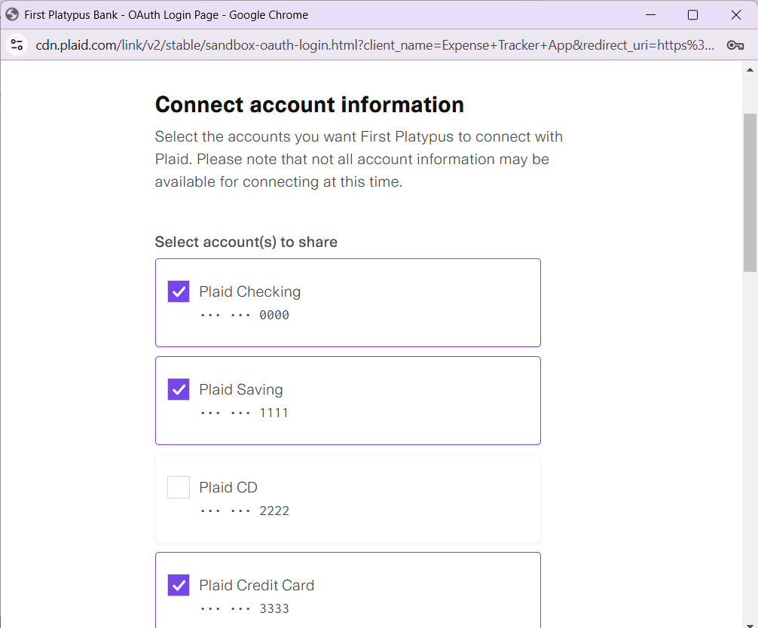
2.2-MAIN FEATURES DEMO
Automated integration with banks through PLAID

Slide 5
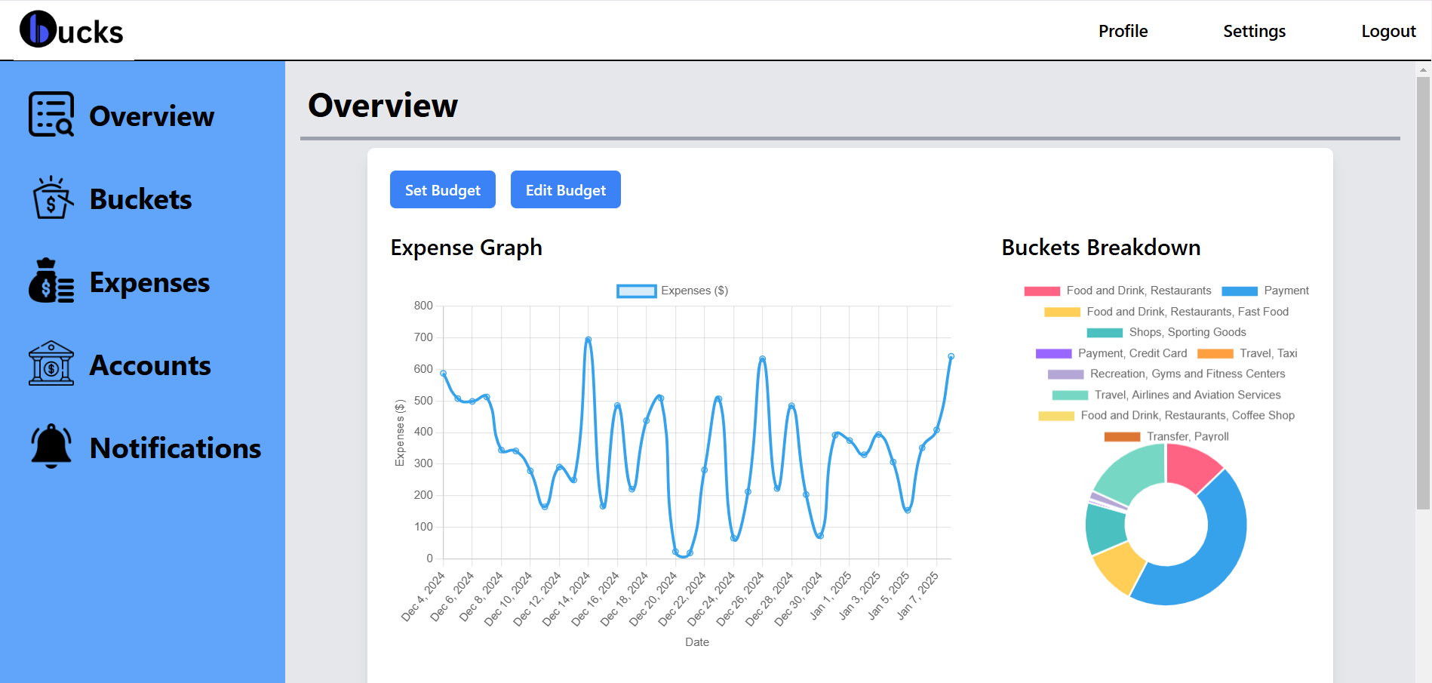
2.3-MAIN FEATURES DEMO
Tracking of budget with customization

Slide 6
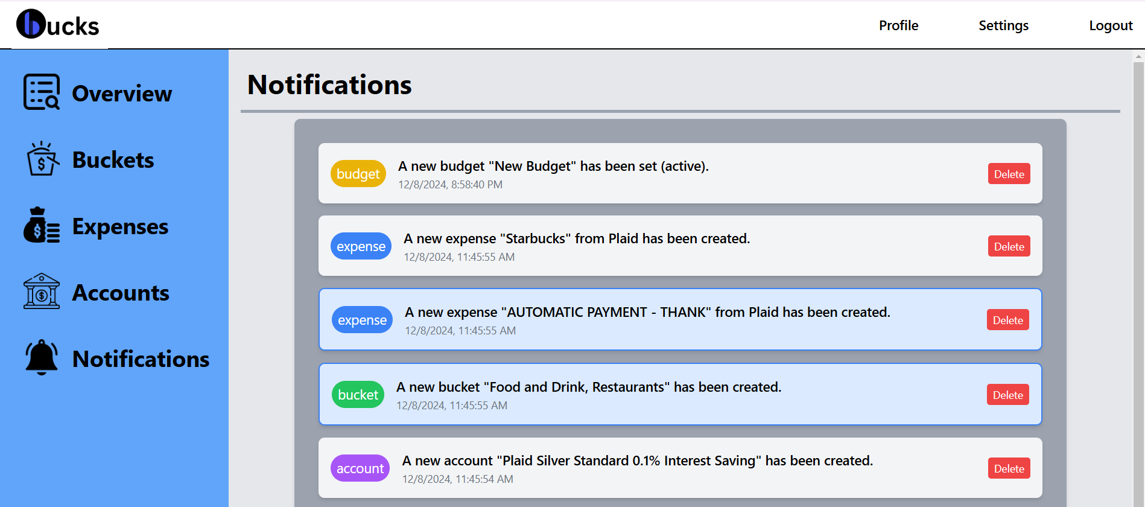
2.4-MAIN FEATURES DEMO
Notification system for financial activities

Slide 7
3-GOALS OF BUCK$
Increase our user’s awareness on spending habits
Automate categorization for expenses
Integrate with multiple accounts

Slide 8






4-PATH TO INTEGRATION
FRONTEND
BACKEND
DATABASES
TypeScript
React.JS
Python
Django
MySQL

Slide 9



5-CHALLENGES
Issue with CSS for styling
Issue with Login Process
Issue with Database Migrations

Slide 10




6-OVERALL REFLECTION
Use of Tailwind
Authentication System from Frontend to Backend
There are still a great deal to learn: deployment, containerization, ...
Four hours of focus is prime level for productivity

Slide 11
7-PERSONAL LEARNING
I realized that I am more into implementation than planning
Sometimes, I need to take a walk, then the solution become obvious.

Slide 12
8-ACKNOWLEDGEMENTS
Prof. Deanna Wilborne
Berea College
Classmates
Notable mentions:
VS Code
Tailwind
Plaid
Rest-Framework

Slide 13
Thank you!!!

